Slide 1

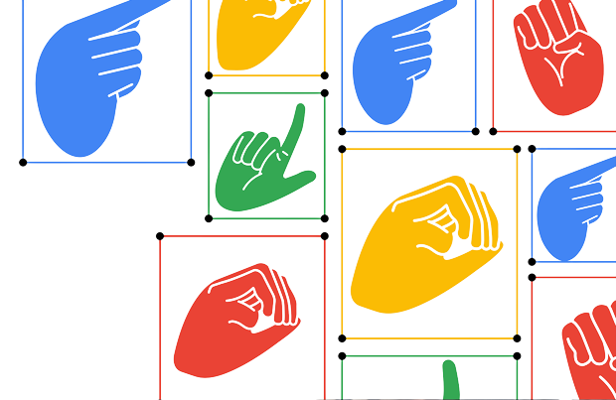


Sign Language Gesture Recognition Using Computer Vision in Real-time
​
ITCE 499/ ITNE 402
Senior Project
Prepared by ​
Puja Karmakar 20194981 ​
Afifa Mohamed Ismaeel Altorabi 20183087 ​
Zainab Redha Ebrahim Matrook 20195982
Project Supervisor: Dr. Jalal Mohamed Mufleh Khlaifat

Slide 2
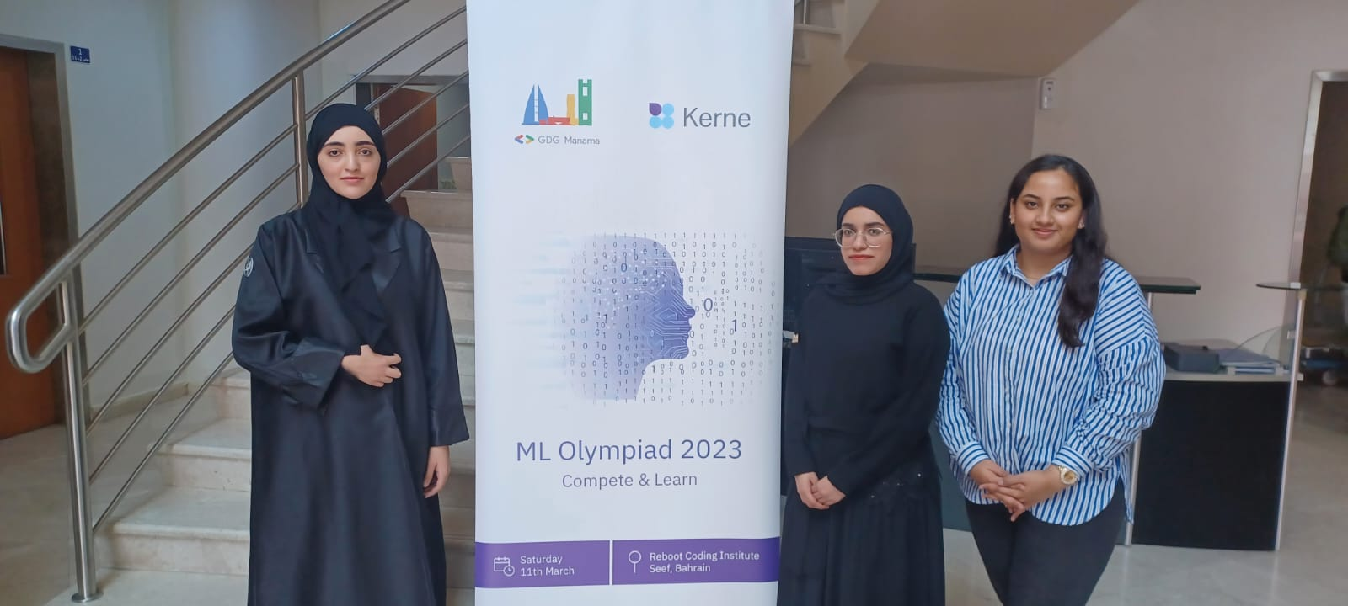
Sign Language Gesture Recognition Using Computer Vision in Real-time

Slide 3

Outline
01
04
Introduction
System Implementation
Problem Statement
Project Objectives
Significance
Methodology
Software Implementation
Raspberry Pi Implementation
02
05
Background and Literature Review
Testing and Result
03
System Design
06
Conclusion and Future work
Dataset Collection
Keypoints Extraction
Labelling and Pre-processing
Model Building
Evaluation, Training
3

Slide 4
Problem Statement
(WHO) states that by 2050, 2.5 billion people (1 in every 10 people) are expected to have some degree of hearing loss with at least 700 million people will need hearing rehabilitation.
Communication Barrier
Speech and hearing-impaired people use hand signs to communicate, hence normal people face problems in recognizing their language
Gesture Recognition System
Recognize 45 Word-level ASL Gestures
Video Stream inputs using OpenCV
Keypoints Extraction with Media Pipe
Enable recognition using ML on Real-time
Benefits of SLGR
Improving accessibility and inclusiveness
Automatic Generation of text translations
Facilitating seamless interaction
4

Slide 5
Objectives
01
Develop real-time Sign Language Action Gesture Detection using Computer Vision techniques.
05
Train models using TensorFlow with video streams on various numbers of sequences, frames, and words.
02
Investigate and develop Machine Learning (ML) models SVM-LSTM-CNN and evaluate feature extraction.
06
Determine model’s best accuracy after rigorous testing and evaluation.
03
Enhance precision and dependability.
07
Hardware implementation and Deployment on Raspberry Pi3
Optimize the model performance with respect to speed and computational efficiency for real-time operation.
04
08
Critical appraisal of each model's strengths and limitations.
5

Slide 6
Significance
SLGR project improves quality of life for individuals with hearing impairments
Real-time performance enables participation in real-time conversations
Develop assistive technologies for individuals with hearing impairments
Develop smart home systems to recognize sign language gestures to control devices
Improve communication between healthcare providers and patients with hearing impairments
Promote social inclusion and diversity by teaching sign language.
6

Slide 7
Methodology
ASL Dataset collection
Dataset preprocessing
MediaPipe
Feature extraction
Predicted Action Generation
Real-time Gesture Recognition
Model training
SVM, LSTM and CNN
7

Slide 8
Background and Literature Review
Colored Gloves
Visual Frames CNN
YOLO
Convolutional neural network (CNN) with a spatiotemporal attention mechanism was developed as a unique approach for sign language action identification.
Produced innovative findings on a benchmark dataset of Chinese Sign Language gestures, outperforming other cutting-edge algorithms with an accuracy rate of 93.7%.
Y. Song et al. used the YOLO approach to hand gesture recognition in real-time applications, reaching a high accuracy rate of 99.4%.
Wang and Popovic created a real-time hand-tracking program using colored gloves.
Tracks hand motions and more correctly cope with segmentation and occlusion concerns
Color pattern of the gloves was recognized by the K-Nearest Neighbors (KNN) technique,
system requires continuous feeding of hand streams, and wearing gloves always
Impractical in daily life
Data gloves with probes frequently limit the natural movements of the signers
R. Sharma et al. trained a machine learning model using 80000 distinct numeric signs with more than 500 photos per sign.
Pre-processed picture training database for a hand-detection system and a gesture recognition system.
W. Liu et al. conducted hand tracking in 2D and 3D space and classification accuracy of about 98% by employing skin saliency.
Feature extraction approach extracts certain pixel data characteristics from pictures and feeds to CNN for quicker training and more accurate prediction.
8

Slide 9
System Design
01
Dataset Collection
02
Holistic Keypoints Extraction
Our system explores techniques ​
for training and forecasting 45 Dynamic American Sign Language (ASL) Gestures on Word-Level
Video and image classification approach ​
Prediction based on detections using MediaPipe Keypoints with help of OpenCV​
ML algorithms like SVM, CNN and LSTM
03
Labelling and Pre-processing
04
Model Building
05
Model Evaluation
06
Model Training
9

Slide 10
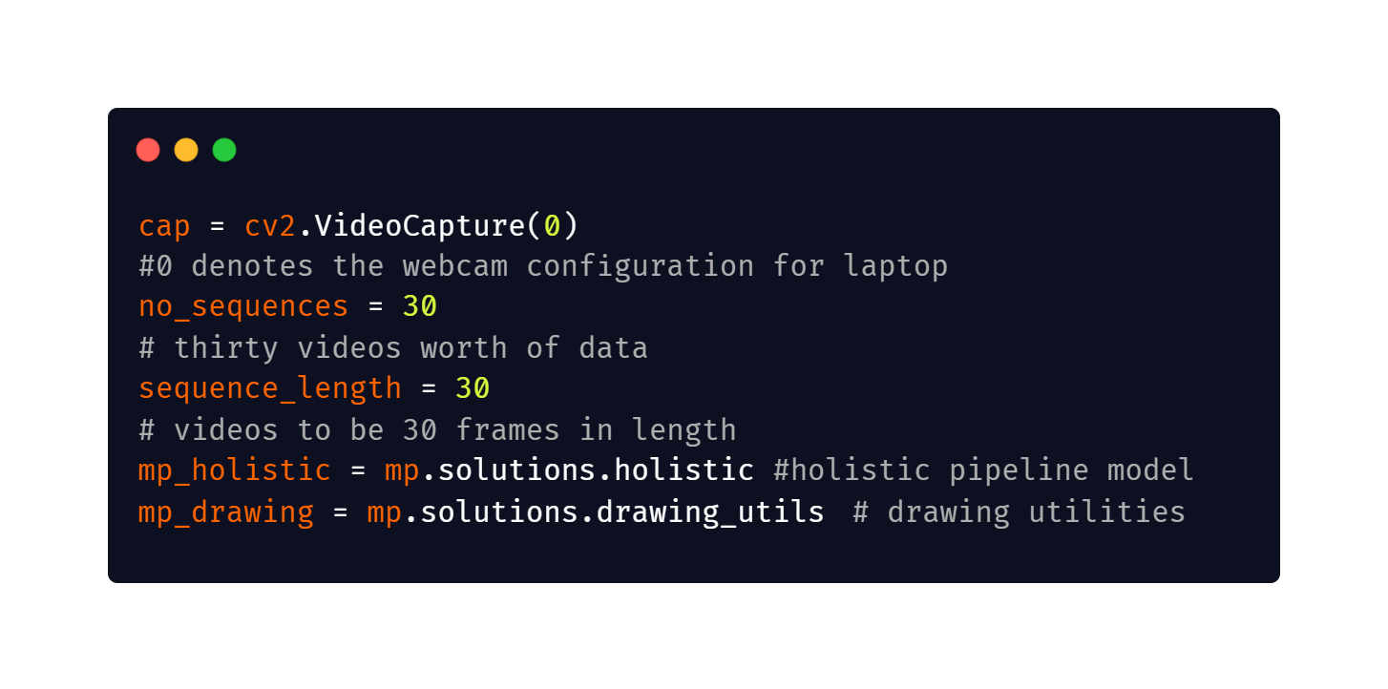
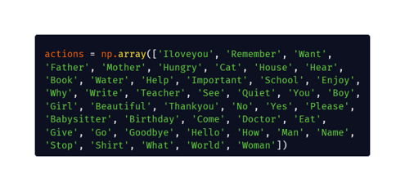
Dataset Collection
Dataset Generation
45 word-level action recognition to text
Video stream data as our input by using Open-CV is segmented into 30 frames
For 45 SL gesture we have (30*45) 1350 images loaded as input
We used MediaPipe Holistic model with 1662 Keypoints
To identify an action in a video, 30 separate frames or 30*1662 keypoints
10

Slide 11
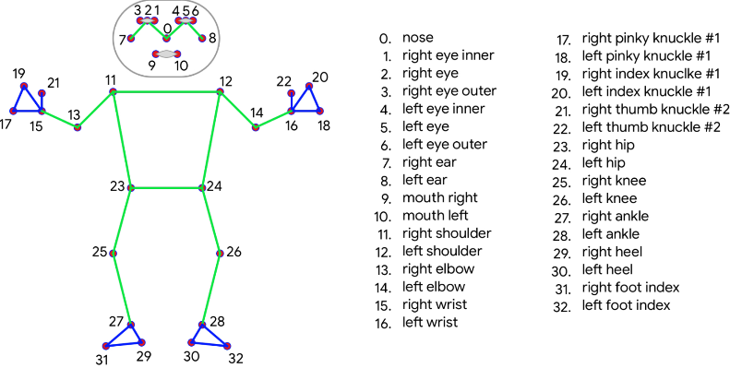
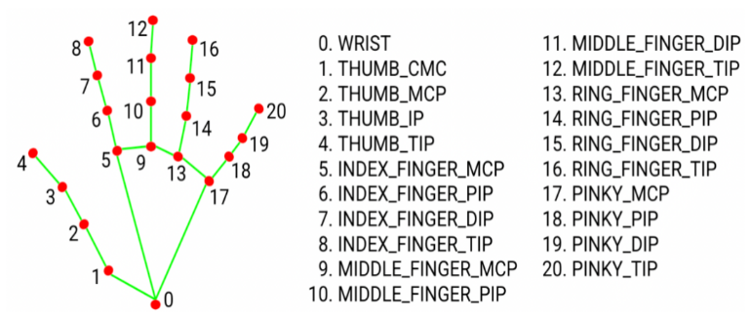
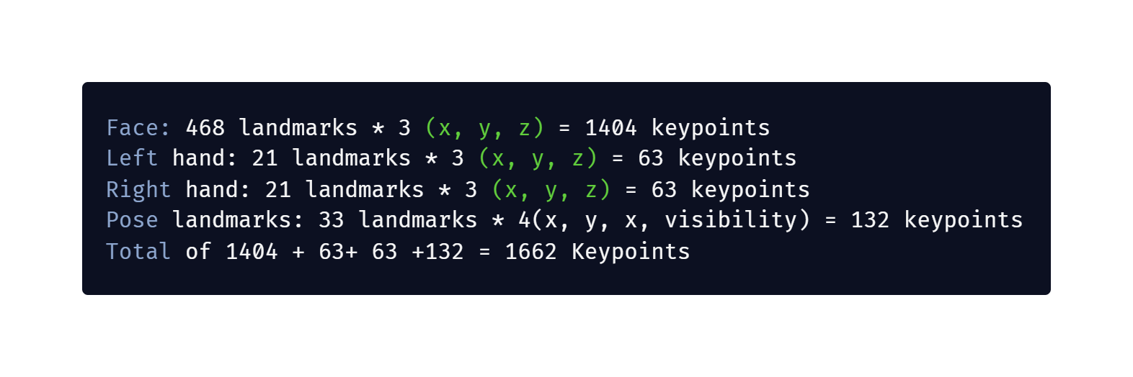
Dataset Collection
Dataset Preparation using MediaPipe
Holistic Keypoints
Mediapipe Holistic utilizes the Pose, Face, and Hand Landmark models
MediaPipe Face Mesh and MediaPipe Hands respectively generates a total of 543 landmarks (468 face landmarks, 33 pose landmarks and 21 landmarks per hand)
MediaPipe provides estimations of 2D human joint coordinates in each frame of the video
Figure 1: Definition of landmarks in Mediapipe Pose and Hand Landmark model bundle
11

Slide 12
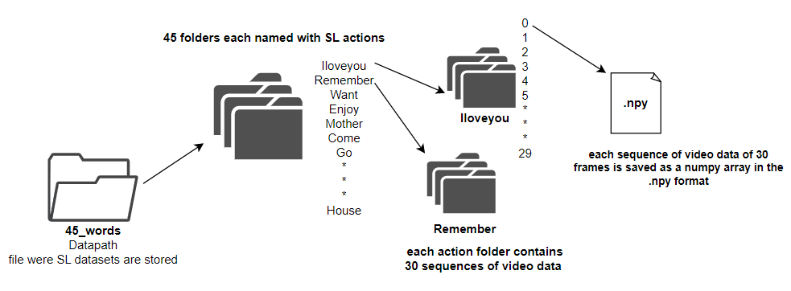
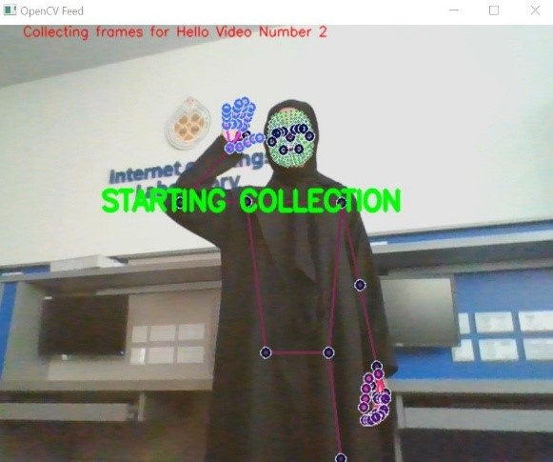
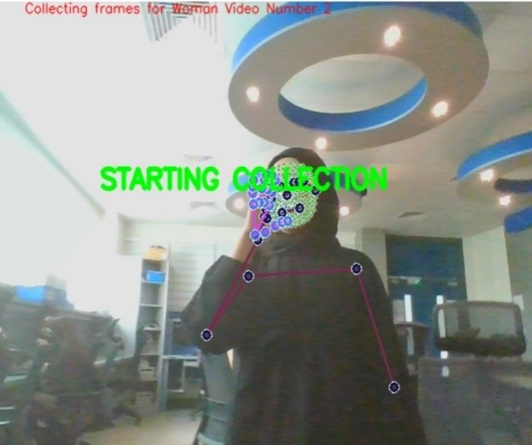
Dataset Collection
Dataset Folder Setup
45 word-level SL Gestures with each action generation requires 30 sequences of 30 frames as NumPy Array
Loops over each action and sequence to read using cap.read() from the specified file path and organize it into actions and draw_landmarks()
Extract and export the landmark keypoints as a NumPy array
Organized the data separated action categories hence the data can be more easily fed into our ML models for training and evaluation
Figure 2: Graphical representation of the folder setup for SLGR
12

Slide 13
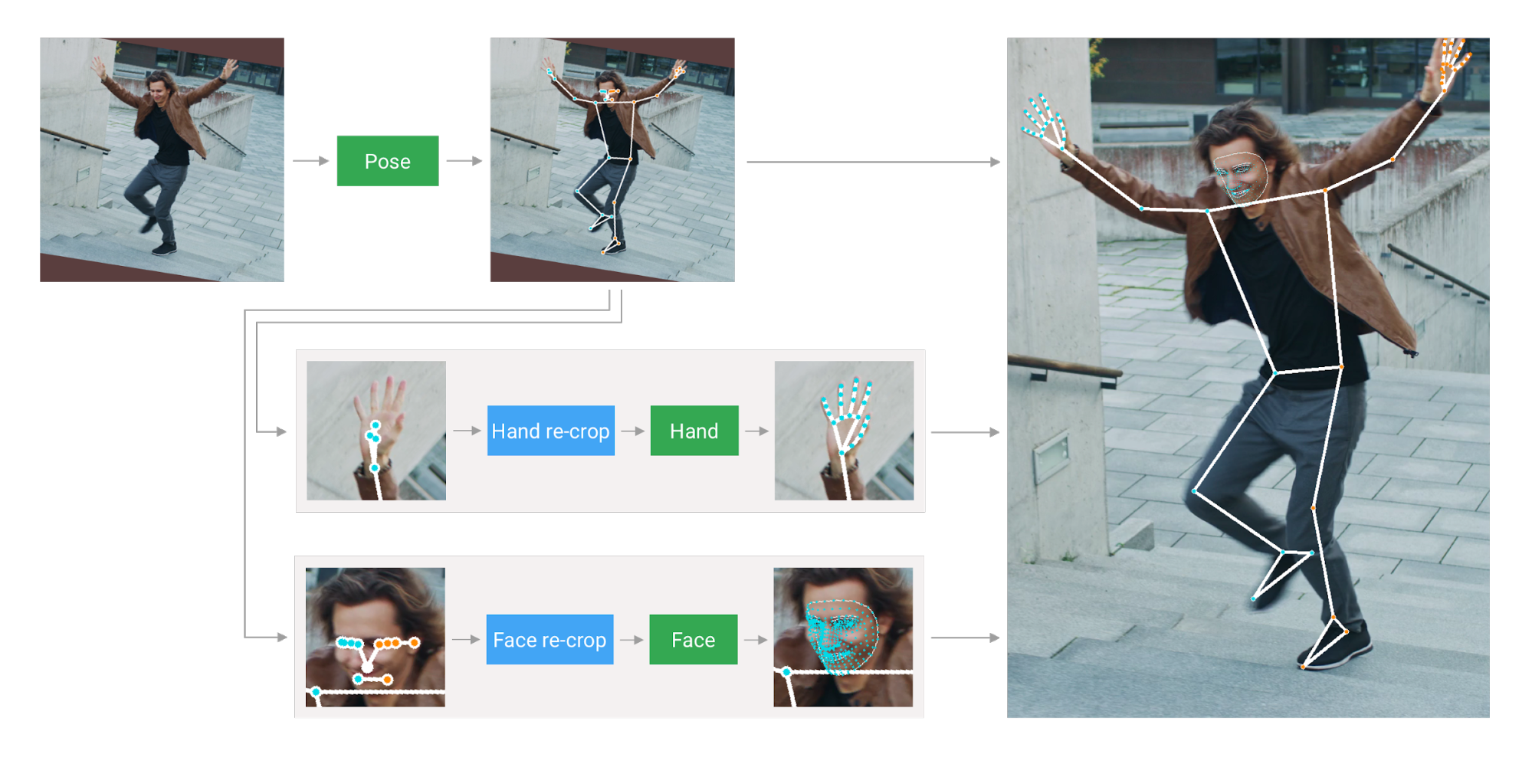
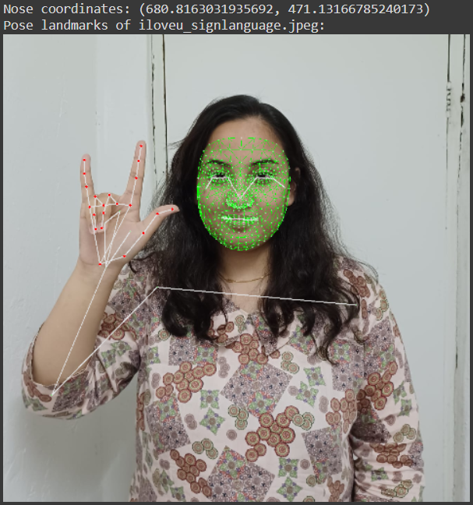
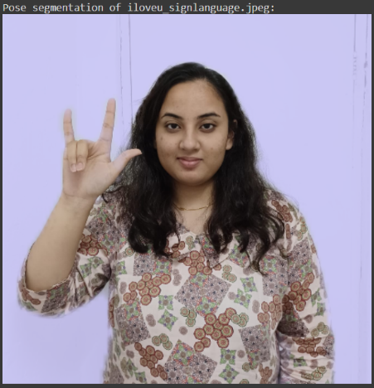
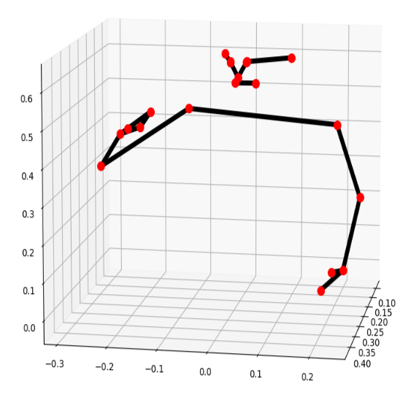
Holistic Keypoints Extraction
Model
Configuration Options
Incorporates pose prediction, predicts the position of body parts in each frame and serves as an additional ROI
Ensures model maintains semantic consistency
MediaPipe Holistic takes an RGB image and produces landmarks
Landmark-tracking in model uses segmentation and draw landmarks and extract its values to plot a 3D Pose Landmarks
Figure 3: MediaPipe Holistic Pipeline Overview
Figure 4: Holistic Model features using Draw, Segmentation Landmarks and 3D Pose
13

Slide 14
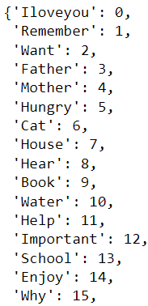
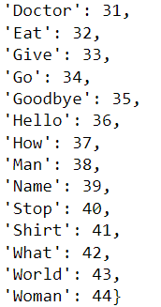
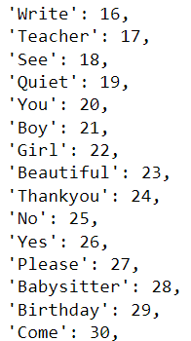
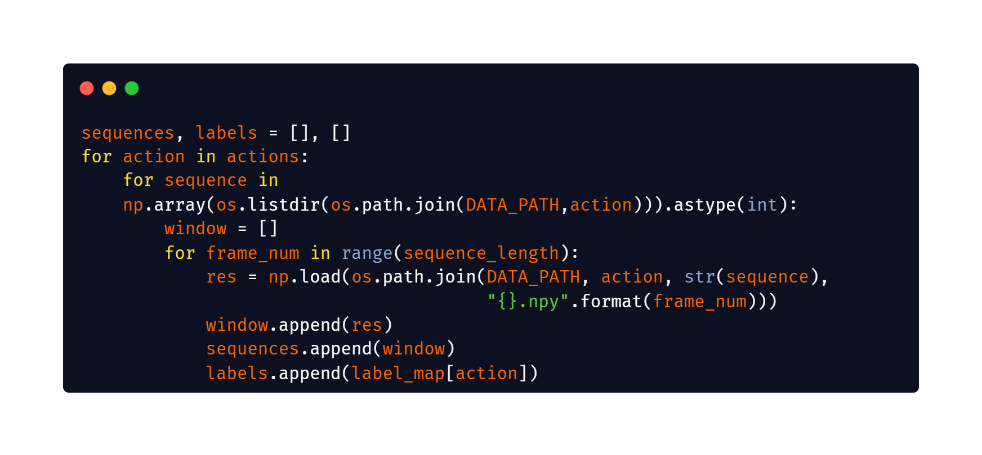
Labelling and pre-processing
Action Labelling
Labels are used in our action recognition tasks to indicate the specific action being performed in each video
Converted our images using OpenCV tools from BGR images to RGB using cv2.cvtColor
Created a dictionary label_map that assigns a unique number to each label
Figure 5: SL Gestures Labels with numerical values
Sequence Loading in Data path

Slide 15
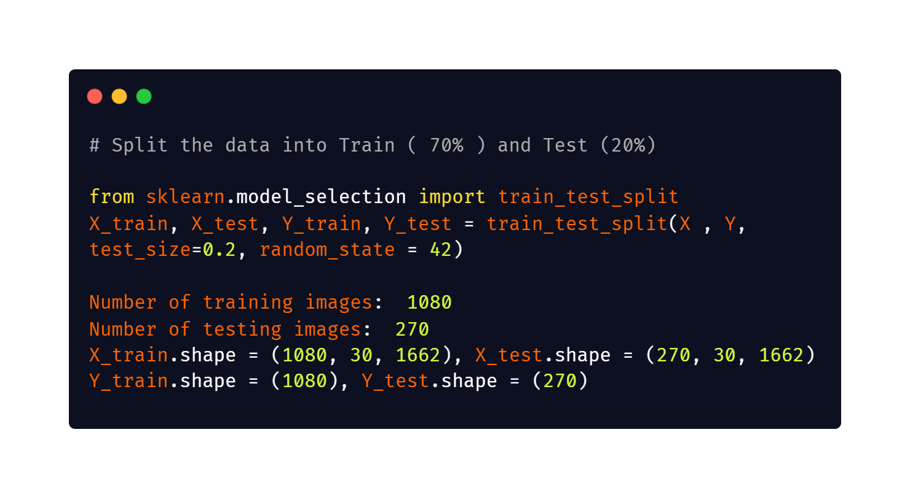
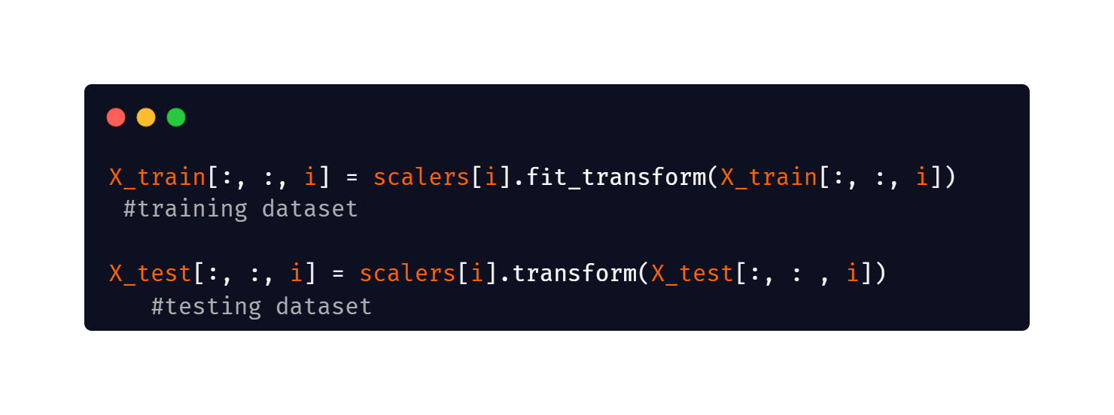
Labelling and pre-processing
Splitting Data for Training Models
We used train_test_split function from the model_selection module of the scikit-learn library
Test size is set as 0.2 (70% datasets for training and 20% for Testing)
Set random seed to 42 (to ensure reproducibility of the split)
Data Standardization

Slide 16
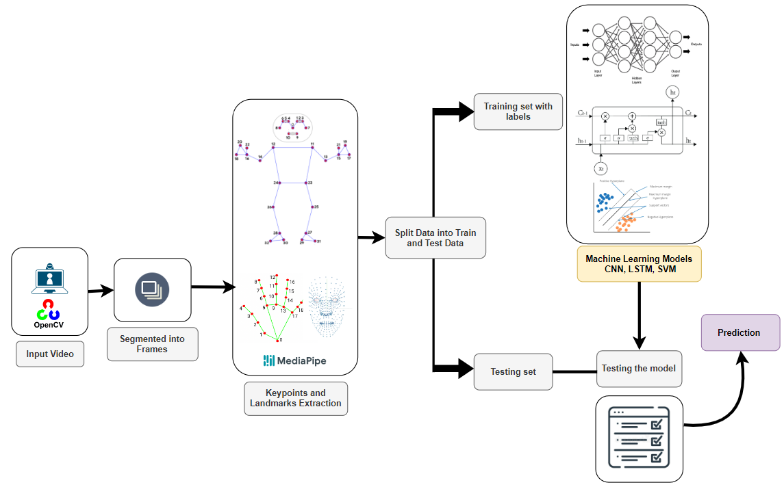
Model Building
Input video (Uses OpenCV’s VideoCapture to load the input video)
Extract frames from the video
Extract the Keypoints and Landmarks using Mediapipe
Label the frames (Object detection and Segmentation)
Apply classifying algorithms to the labeled frames (Using machine learning models such as CNN, SVM and LSTM
Predict the action of each frame
Aggregate the frame-level predictions to make a prediction for the entire video
Figure 6: An Overview of modeling and prediction of our SLGR Model

Slide 17
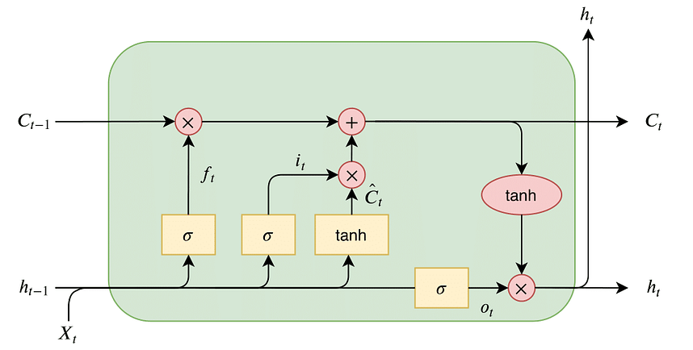


Machine Learning Algorithms
LSTM Model
CNN Model
SVM Model
LSTM (Long Short-Term Memory)
Recurrent Neural Network (RNN)
Supervised Learning
CNN (Convolutional Neural Network)
Image Classification
Unsupervised Learning
SVM (Support Vector Machine)
Binary Classification
Kernel Methods
Supervised Learning
17

Slide 18
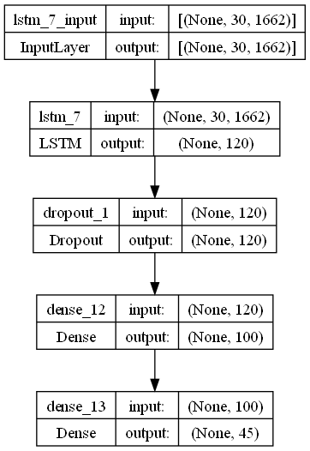
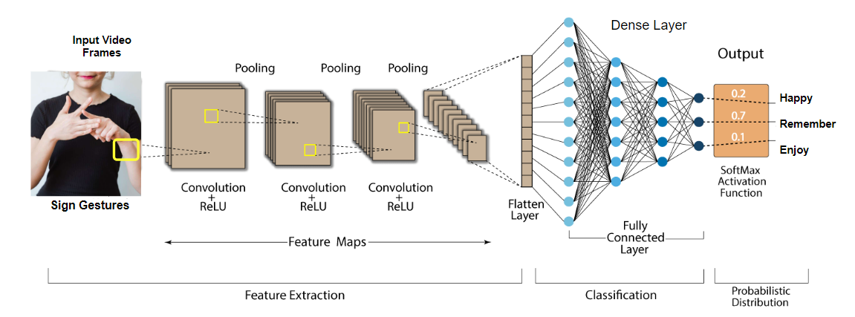
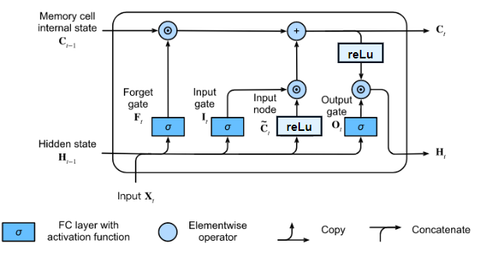
Machine Learning Algorithms
3 Layer CNN Model
LSTM Model
LSTM layer with 120 units input shape of LSTM model is same as the CNN to maintain consistency
Dense layer has ReLu and Softmax
Input: Video time frames 30 and Keypoint Features 1662
Activation funtion: ReLu and Softmax
Figure 7: 3 Layers CNN Model summary and structure
Figure 8: LSTM Model summary and structure
18

Slide 19
Model Evaluation
Dataset Splitting
Measure
verbose parameter
validation_split
epochs
batch_size
Activation functions
19

Slide 20
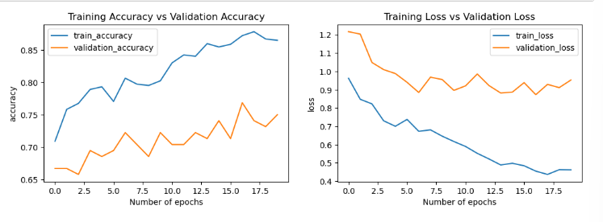
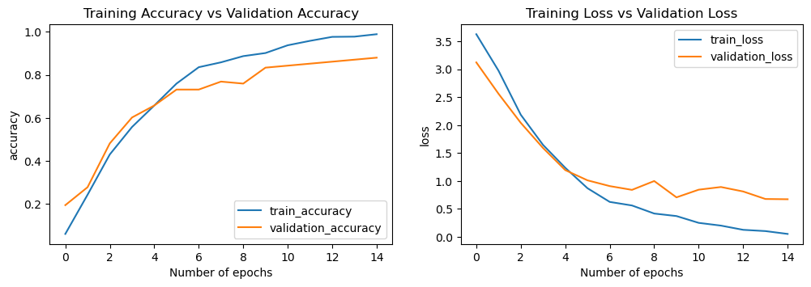
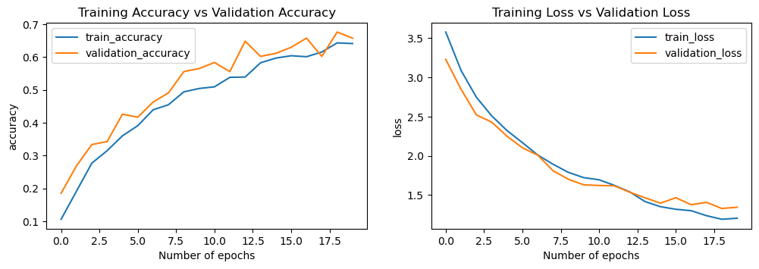
Model Training
Initial Training - LSTM
Final Training
CNN
LSTM
20

Slide 21


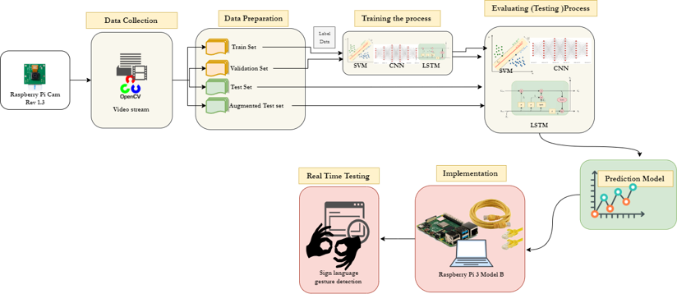
System Implementation
Python 3.9
Tools and libraries
Platform
Jupyter Notebook
Figure 9: Hardware Implementation of GSLR Model
21

Slide 22







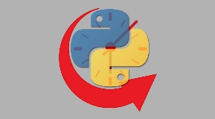

Software Implementation
OpenCV
MediaPipe
TensorFlow
NumPy
OS Module
Matplotlib
Scikit-learn (sklearn)
Keras
time Module
22

Slide 23
Hardware Components
Raspberry Pi 3 Model B
Micro USB power supply (0.35 A)
VNC Viewer (Remote Access)
Micro SD card (32 GB) with Raspberry Pi OS installed
LAN wire
Laptop
The Raspberry Pi Camera Rev 1.3
23

Slide 24
Raspberry Pi Deployment
Raspbian Mirror
Remote server hosting a copy of the Raspbian OS and its packages
PiCamera
Install the IP camera package
Packages and Dependences
TensorFlow 2.4.0
Space
OpenCV 4.7.0.72
matplotlib 3.5.0
scikit-learn0.24.2
NumPy1.21.6
Mediapipe 0.8.13
Memory consumption is 10 GB
Iran Raspbian mirror
Activate Camera Support in raspi-config
24

Slide 25
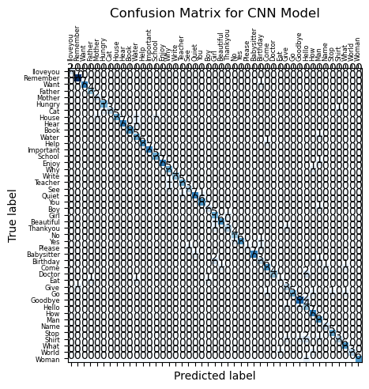
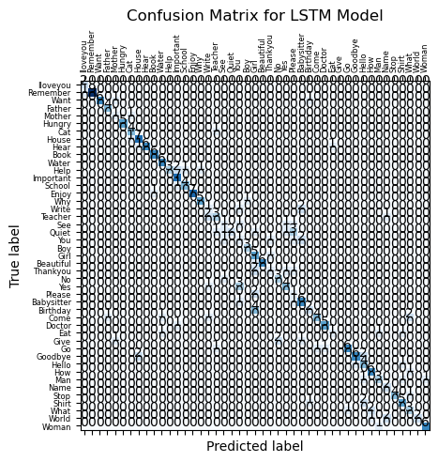
Testing and Result
25

Slide 26
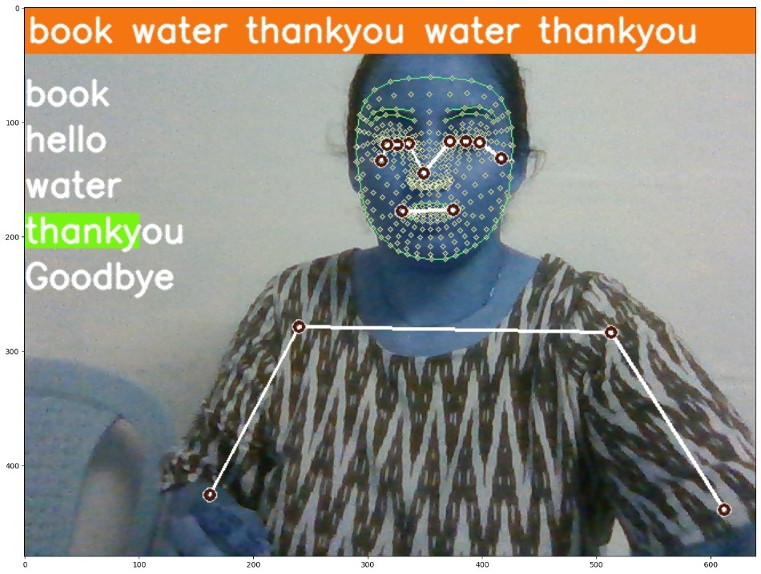
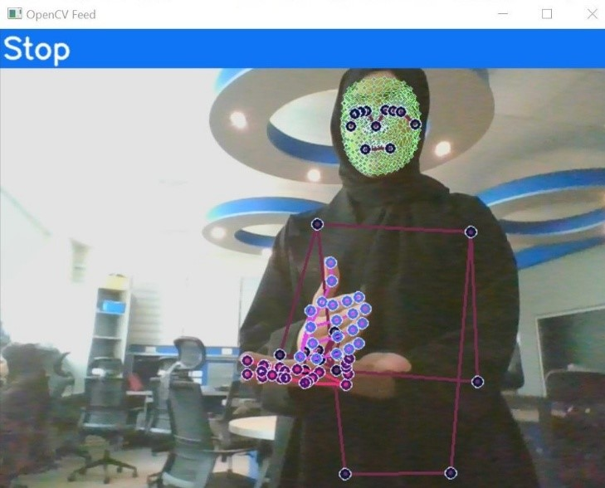
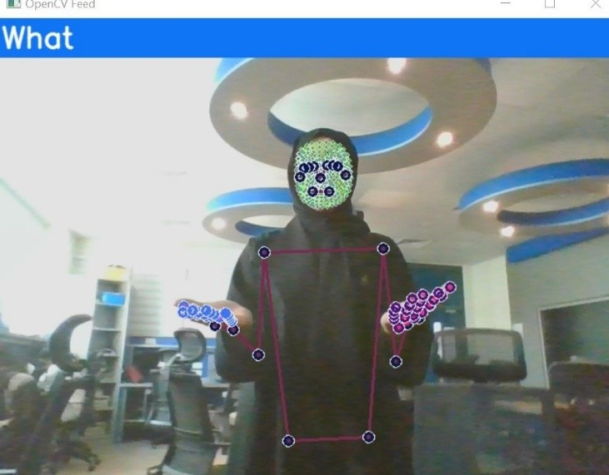
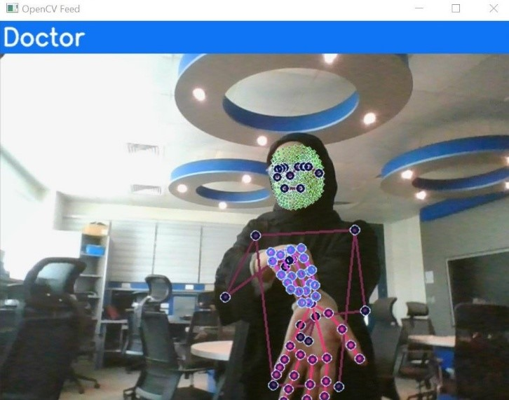
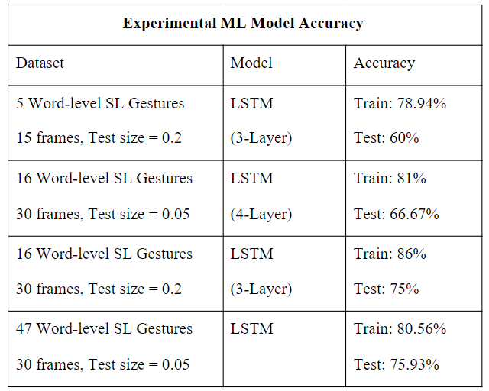
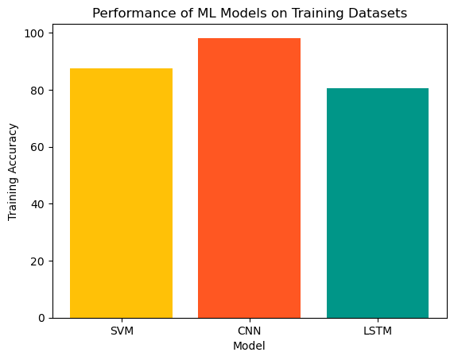
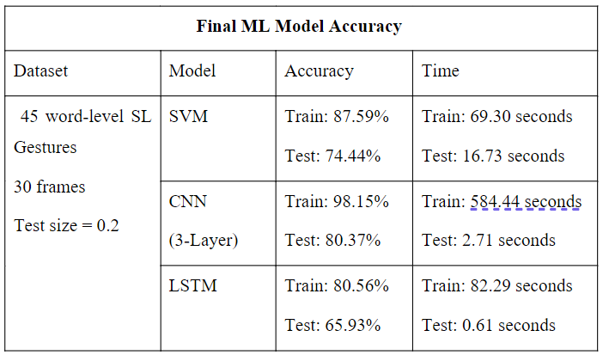
Testing and Result
Initial Result- LSTM
Final Result - 45 actions
26

Slide 27
Challenges
Hardware and software compatibility challenges.
Connectivity issue with Jupyter Notebook on Raspberry Pi due to high processing power and memory usage.
Dataset handling and capabilities
Limited processing power of Raspberry Pi requires external GPU accelerators like Coral accelerator for better prediction and training speeds.
Technical limitations due to Raspberry Pi's limited processor and memory capabilities when working with large datasets for training and testing.
Lag experienced during training period due to GPU compatibility issues.
Solution recommendation: Use external GPU accelerators to offload processing tasks and improve machine learning efficiency on Raspberry Pi.

Slide 28
Conclusion and Future Work
Goal: Create intelligent interfaces by merging sign language recognition, visual idea identification, and natural language-generating technologies to improve communication and aid in automatic text production for accessibility and inclusion.
Evaluation approach: Compare accuracy and consider trade-offs between model complexity, training time, and performance to choose the optimal machine learning model for a specific task.
CNN model: Achieved highest accuracy in all studies, with more than 95% accuracy on ASL dataset.
LSTM model: Performed better in handling parameters compared to CNN model.
Complete deployment of the machine learning model in Raspberry Pi
Analyze sign language recognition predictions for multiple sign languages using multi-modal approaches
Addition of error management
Permit dynamic thresholding
Recognize signs in continuous streams across locations
System has the potential to revolutionize communication for individuals with hearing impairments across various settings, including education, healthcare, entertainment, and social engagement

Slide 29
Sign Language Gesture Recognition Using Computer Vision in Real-time
Demo Work

